Slide 1

W209 Mid-Term Presentations
World Education Statistics
Charlene Chen
Divya Babu
Matt Thielen
Nate Velarde

Slide 2


Overview
Summary: Create dashboards to facilitate comparisons, identification of trends and discovery of relationships between educational indicators, government policies and key macroeconomic/demographic measures at the global, regional and country level
Goal: Enable users to efficiently navigate the World Bank EdStats dataset and aid in the iterative cycle of data exploration, hypothesis generation and testing with the ultimate aim of improving educational policies that improve outcomes

Slide 3
Data / Users / Tasks
Data: The World Bank EdStats All Indicator Query dataset holds around 4,000 internationally comparable features that describe education access, progression, completion, literacy, teachers, population, and expenditures. The indicators cover the education cycle from pre- primary to vocational and tertiary education.
Users: Policy analysts, government education/development officials, NGOs who are interested in dataset from The World Bank EdStats
Tasks:
Discover Feature Availability
Discover distributions of education indicators among countries and regions
Explore relationships between country education indicators and key macroeconomic and demographic measures
[TBD - Cut and Paste From Relevant Slide]

Slide 4
Task 1 - Discover Feature Availability
The dataset has 3,665 unique features, from the record of 1970 to the forecast of 2100, with high sparsity.
For example, many features are related with academic performance tests by multiple organizations, which is not available in most countries.
Demographic information detailed to minor age groups is not available for most countries and years.
Therefore, for users who would like to get helpful insights from this dataset, discover feature availability is important as the first step.
Then users are able to filter the interesting topic and features from the dashboard to dig into.

Slide 5
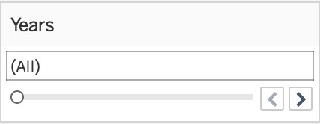

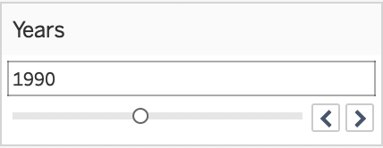
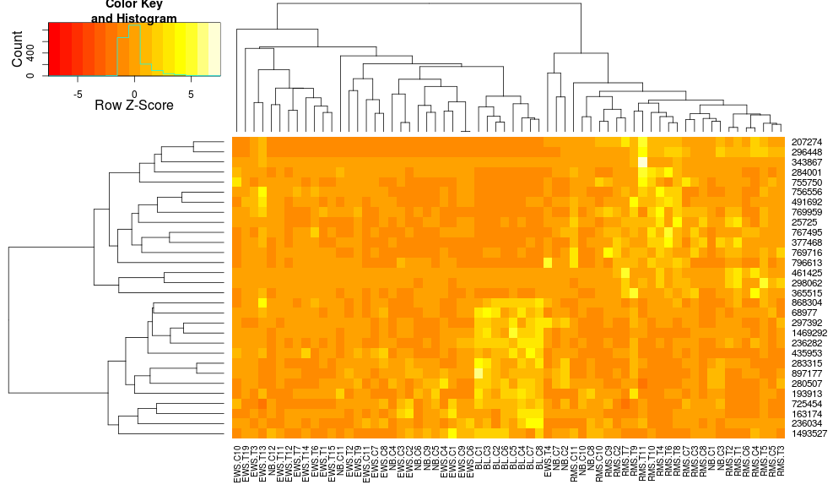

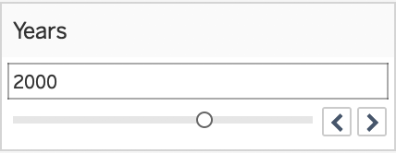

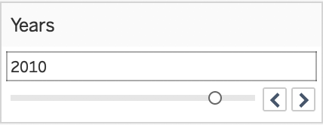
Task 1 - Dashboard Overview
Heatmap overview
Trends by Year
Features
Countries
Features/indicators
Group*
...
...
* Group by educational indicators, government policies and key macroeconomic/demographic measures at the global, regional and country level, for Female and Male and both genders.

Slide 6
Task 1 - Sample Testing Plan
Identify the group of countries, which has the most data points available.
Identify the group of features/indicators, which is subject matter and has most data points.
Identify the trends of feature availability, when slide years from 1970 to 2017.

Slide 7
Task 2 - Discover Distributions
Discover distributions of primary educational attainment among countries and regions by high level demographics, such as overall population and gender
Subtasks:
Identify Distribution Outliers
Regional Outliers (In Global Scope)
Country Outliers (In Global Scope)
Country Outliers (In Regional Scope)
Identify Regional Similarities
Generate Hypotheses

Slide 8
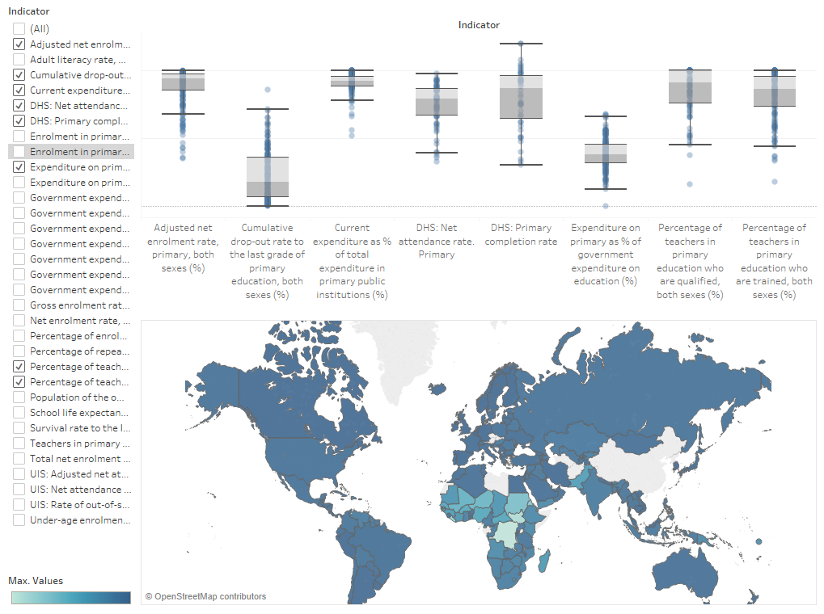
Task 2 - Dashboard Mockup
Unlinked dynamic visualizations
Allows users to select desired indicators and brush over regions of interest
Current
Iteration
Reversible linked highlighting
Select region on map to discover regional outliers on box plots
Brush box plots to see if outlying regions exist
Future
Iterations

Slide 9
Task 2 - Sample Testing Plan
Example Task List:
Identify a region that is a global outlier with respect to primary education net enrollment rate for both sexes.
Identify a South American country that is a regional outlier with respect to a primary education indicator.
Identify an Asian country that is a regional outlier with respect to child survival rate through their primary educational years.
Identify a country that is a global outlier with respect to percent of GDP spent on primary education.
Formulate a hypothesis that might explain one of the phenomena you discovered.

Slide 10
Task 3 - Explore Relationships
Explore relationships between country education indicators and key macroeconomic and demographic measures
Subtasks:
Identify outliers/countries of interest
Analyze and compare trends of key indicators/measures
by geographic region / income group
by country(ies) of interest [DR]
Summarize differences versus global/regional/custom comparison group averages
Notes:
Example relationships that can be explored:
Rate of Female Enrollment in Universities versus Population Growth
% of Labor Force with College Degrees vs per Capita GDP

Slide 11
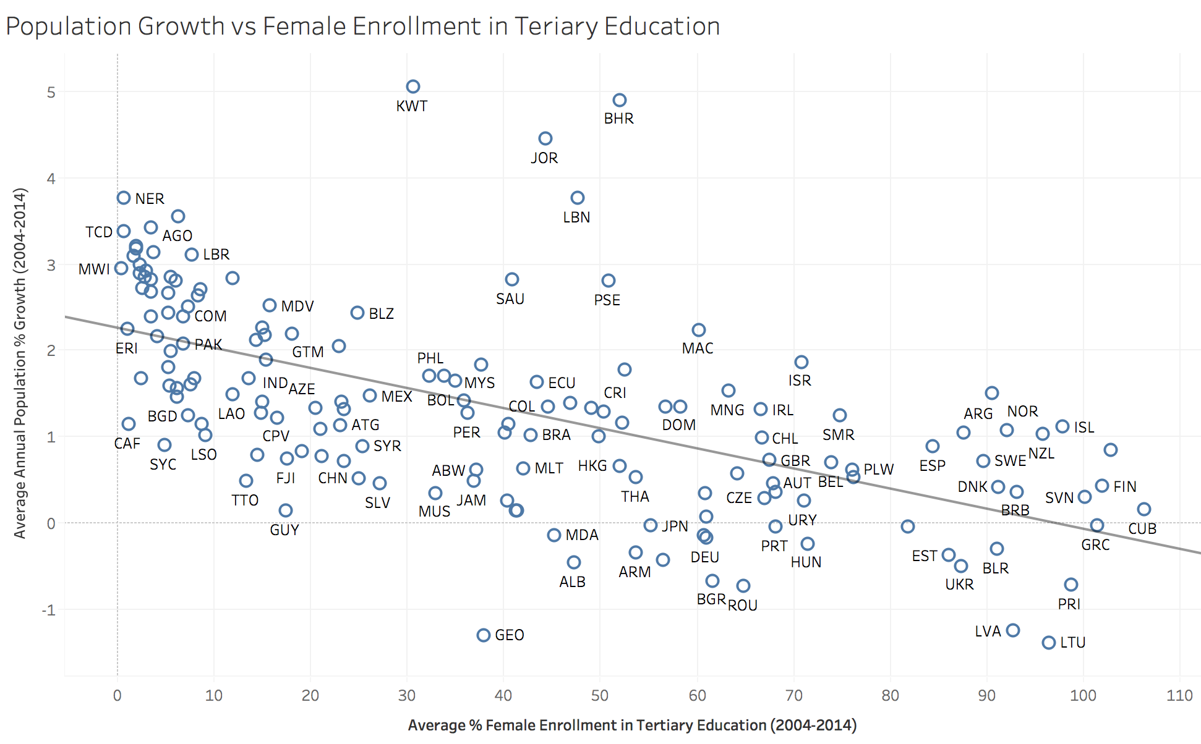
Task 3 - Example Use Case
User Hypothesis
Higher levels of female educational attainment are associated with lower population growth
Insight
Visualization supports hypothesis and prompts user to take the “natural” next step of digging deeper into the outlier countries in the top left and bottom right quadrant

Slide 12
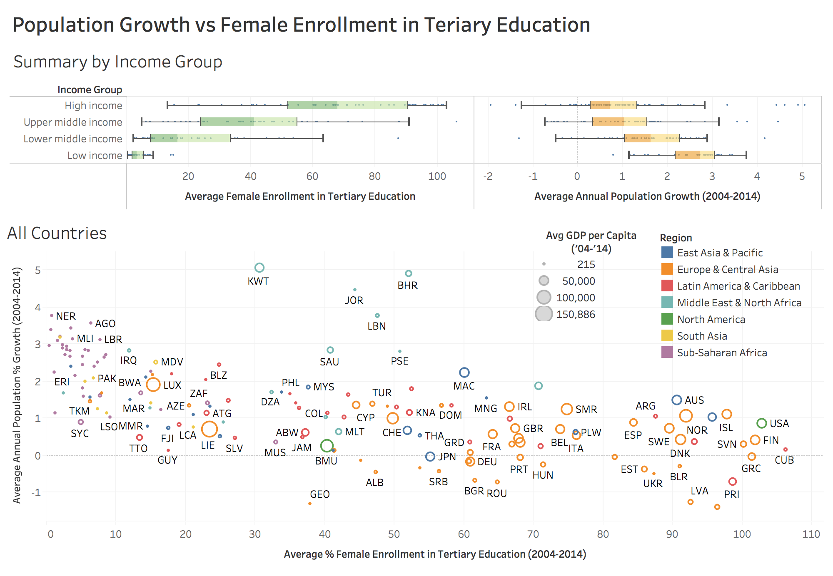
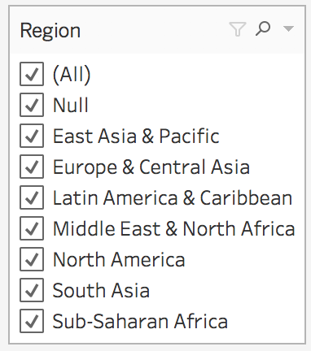
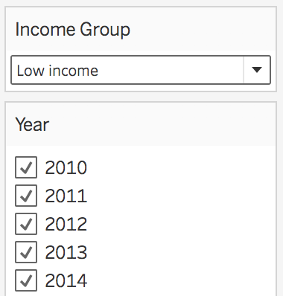
Task 3 - Dashboard Mockup
Current
Iteration
Static
Visualizations
Allow users to select indicators and measures to compare
Filtering by:
Region
Income Group
Year
Future
Iterations
Insight
“Problem” countries concentrated in Sub-Saharan Africa and South Asia
Notes:
Start with showing distributions of measures to compare -
mention alternative view -- could use heatmaps where the size is related to the macro variable and the color is the educational indicator or vice versa
Scatterplot is most efficient way to show relationships between two variables
Building on the last slide, filtering by region shows that most of the problematic countries (low female educational attainment and high population growth) are in Sub-Saharan Africa and South Asia

Slide 13
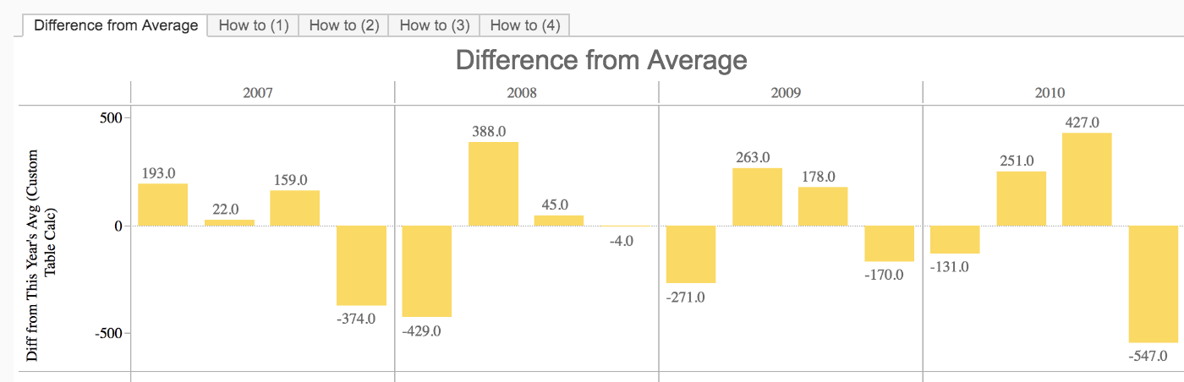
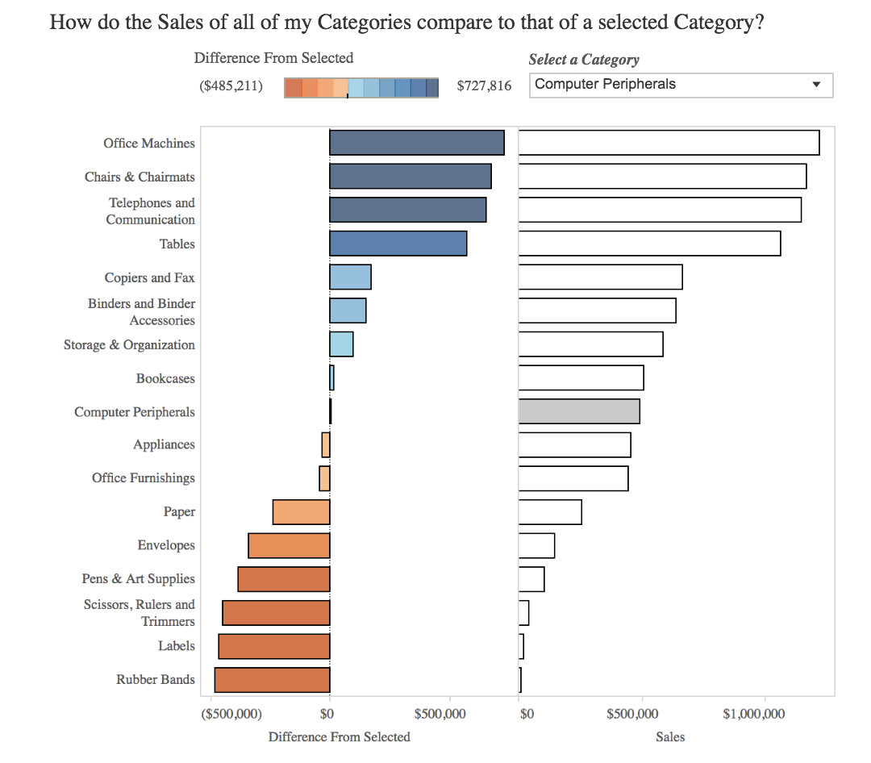
Task 3 - Dashboard Mockup - Subtasks
Facilitate comparisons on multiple measures between target countries and comparison group across time
Future
Iterations
Notes:
Adding Additional Interactivity
Comparison of target country versus comparison group average (global/regional/income group)
Want a scatterplot by individual year -- walk through evolution of relationship for a particular country over time

Slide 14
Task 3 - Sample Testing Plan
Example Task List:
Select an educational indicator of interest and see if there is a relationship with per Capita GDP Growth
Does the relationship change when comparing:
All countries
Countries in the same geographic region
Countries in the same income group
Highlight any outliers/countries of interest - are there any commonalities by geographic region or income group?
For the selected country, document trends in the educational indicator and GDP per Capita over time
Create a comparison group
How has the selected country performed on these measures versus the comparison group average over time?

Slide 15
Task 4 - Compare Trends
Analyze and compare trends of key education indicators and key macroeconomic and demographic measures
Subtasks:
Identify trends in education indicators vs macroeconomic and demographic measures for specific country
Explore the contribution of individual categories to the overall trends.
(for example, dropout rate in different primary grades)
Notes:
Identify deviations, if any, from overall trends of a specific indicator for a specific country

Slide 16
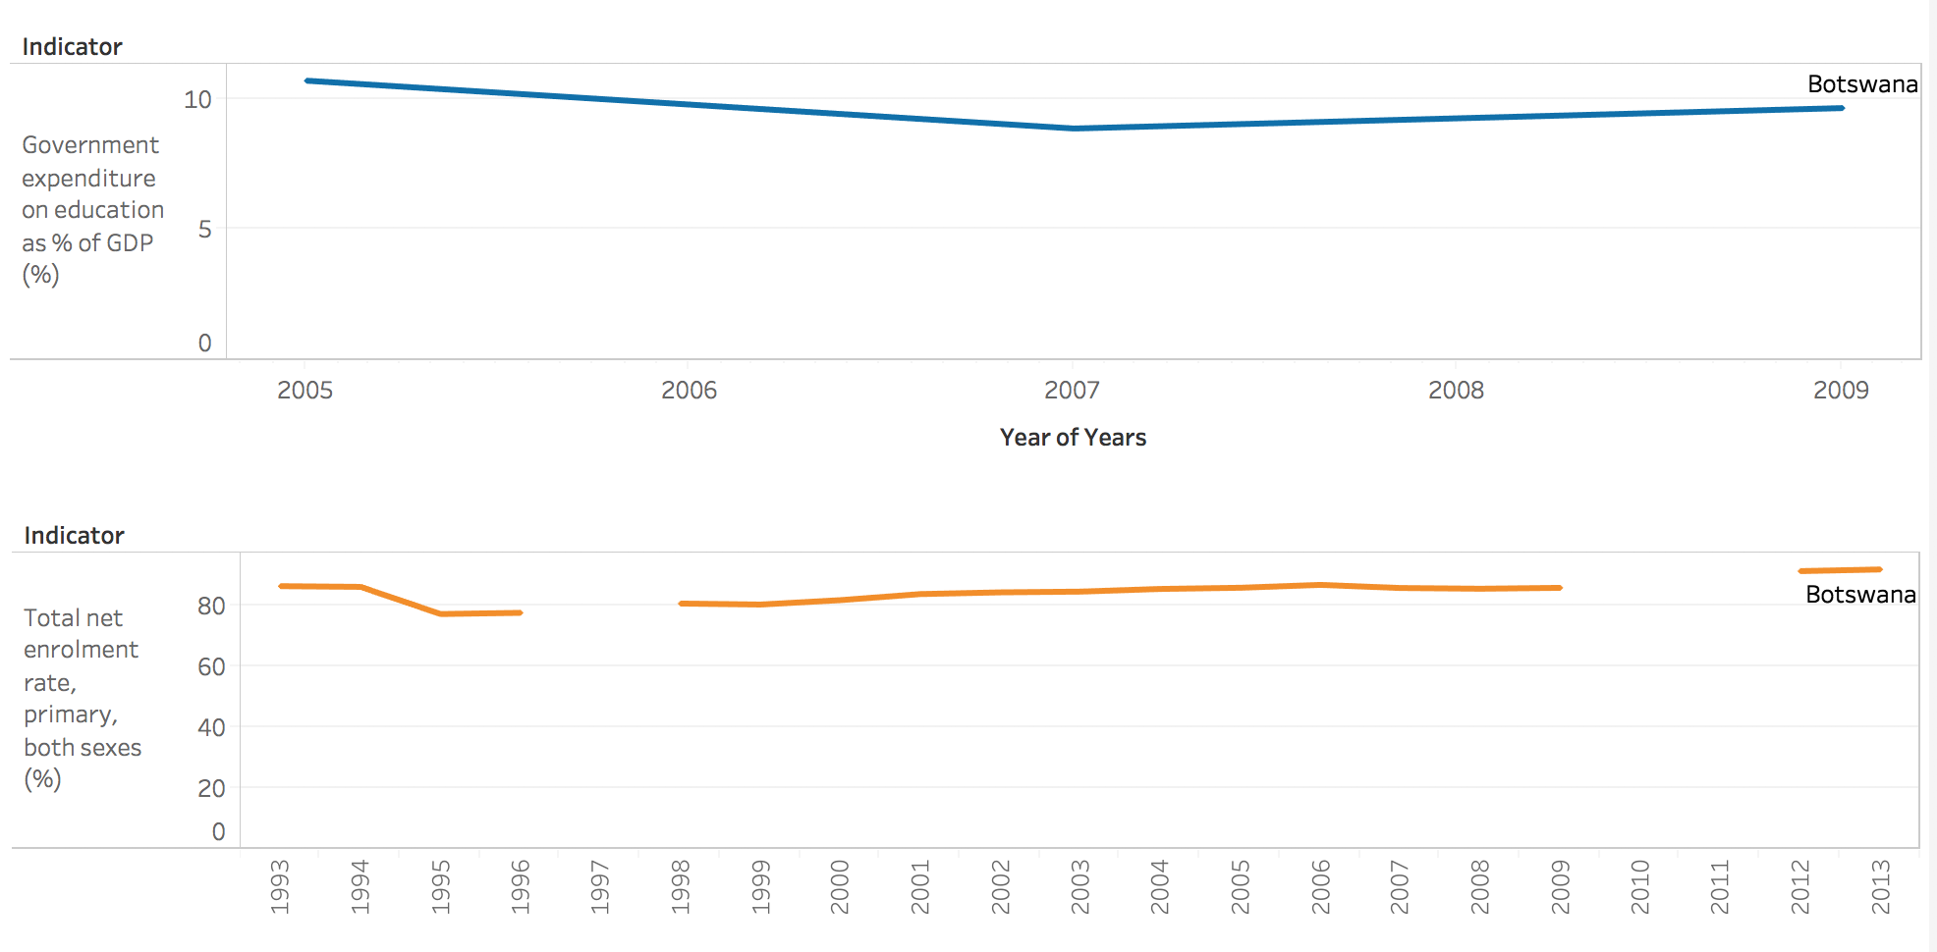
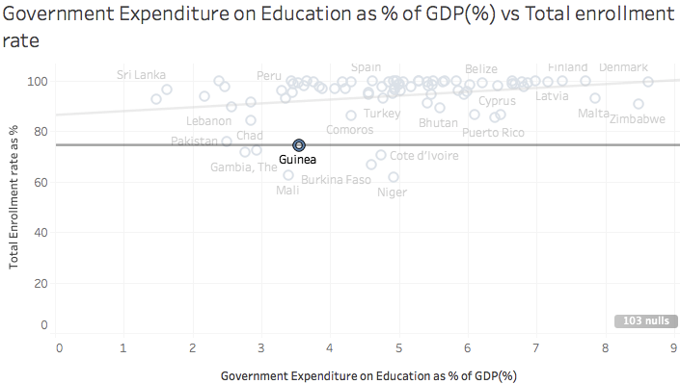
Task 4 - Example Use Case 1
Hypothesis: Primary education enrollment rate increases with an increase in government expenditure on education
Current
Iteration
Manual selection of indicators for comparing trends
Data munging is needed to show both correlation and comparison views
Selecting a country from correlation view should display trends for that country in comparison view
Future
Iterations
Insight: The trends for each country may differ. The user can use this data to further explore the other macroeconomic or demographic indicators(or other qualitative factors not covered in the data)
Notes:
For example: If we notice that there was a downward trend in primary education enrollment ratio in the same year that a country reduce its expenditure on primary education, then this data can be used to inform policy makers about the potential effects of reducing spending in the future
This data can also be used to encourage certain measures which have resulted in better education indicators.

Slide 17
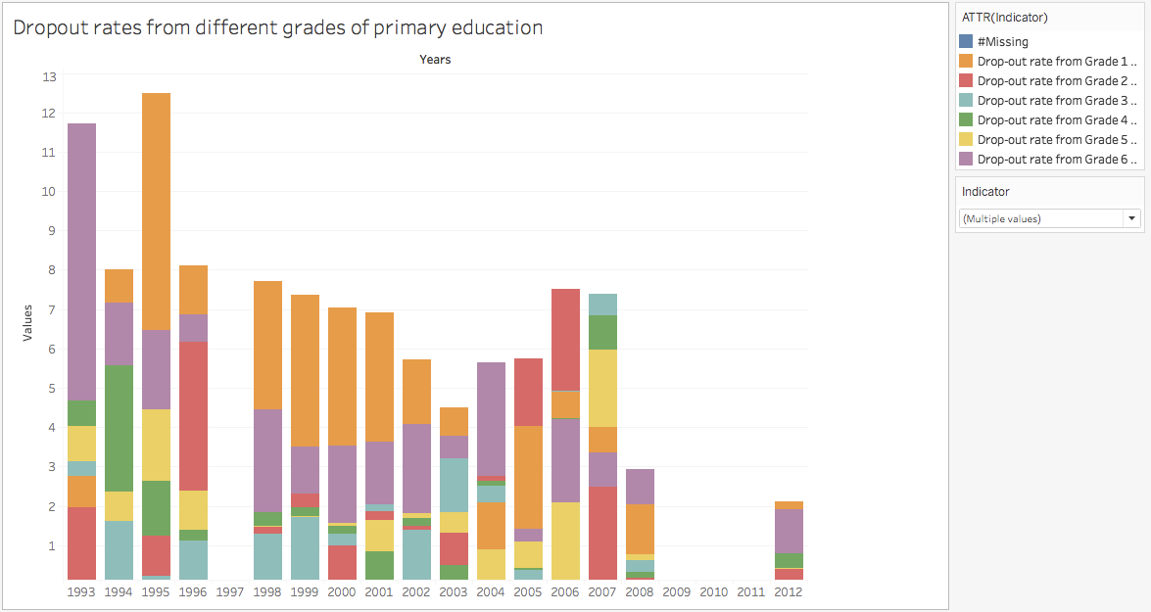
Task 4 - Example Use Case 2
Explore trends of dropout rate at different grades of primary education
Unlinked Dynamic Visualisation
Filter enables user to select indicators
Current
Iteration
Filter only education indicators which have multiple categories
Sorted stacked graphs
Future
Iterations
Insight: If dropouts are higher in certain grades, Policy makers can identify them using this dashboard to take implement concentrated remedial measures

Slide 18
Task 4 - Sample Testing Plan
Example Task List:
Select the indicator of total enrollment rate in primary education and look for trends over time with government expenditure on education.
Select the indicator of total enrollment rate in primary education and look for trends over time with government expenditure on primary public institutions
Identify trends in the same education indicator for e.g Cumulative dropout rate based on gender
Find the grade of primary education which consistently has higher dropout rates.
Find the overall percentage of repeaters from different grades of primary education

Slide 19

Q&A

Slide 20
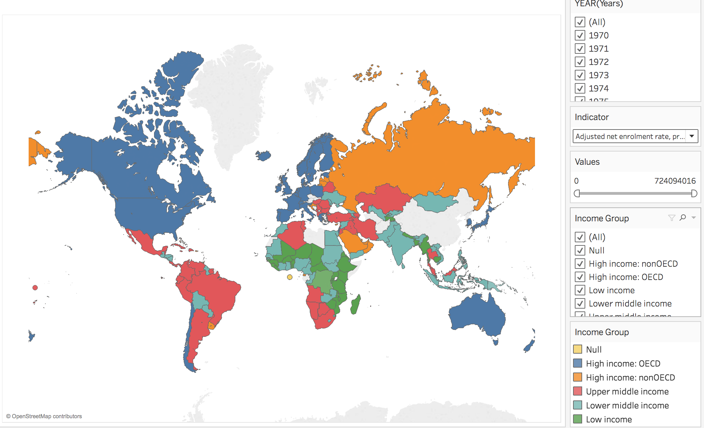
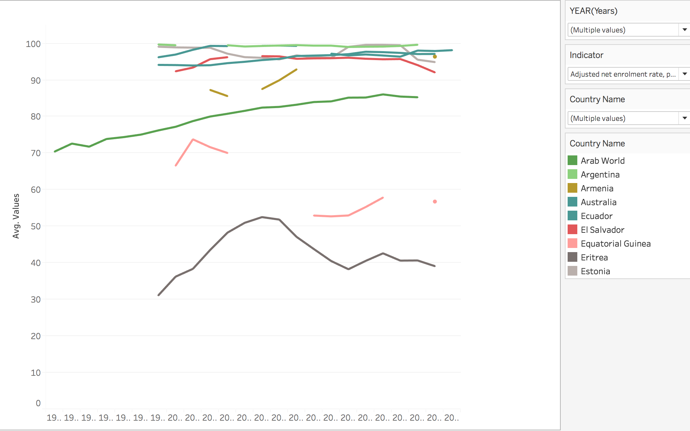
Task 4 - Dashboard Overview
Notes:
This screen makes more sense in Matt’s section as a subtask

Slide 21
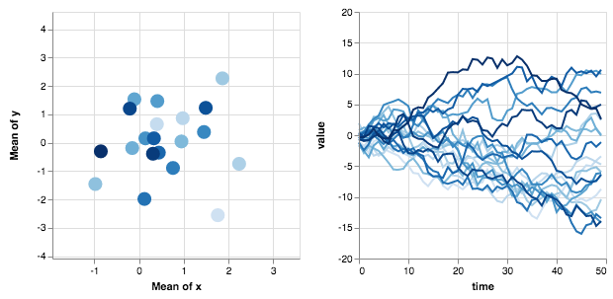
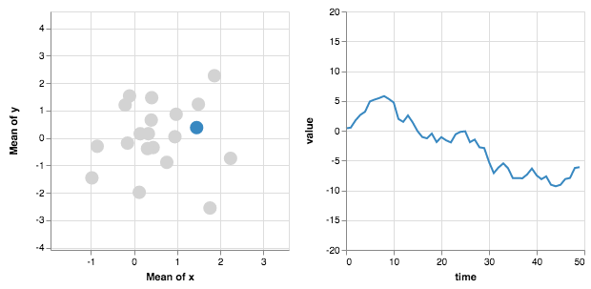
Task [NV] - Dashboard Mockup - Subtasks
Enable user to drill down on individual country(ies) and compare trends
Future
Iterations
Notes:
Adding Additional Interactivity
Want a scatterplot by individual year

Slide 22
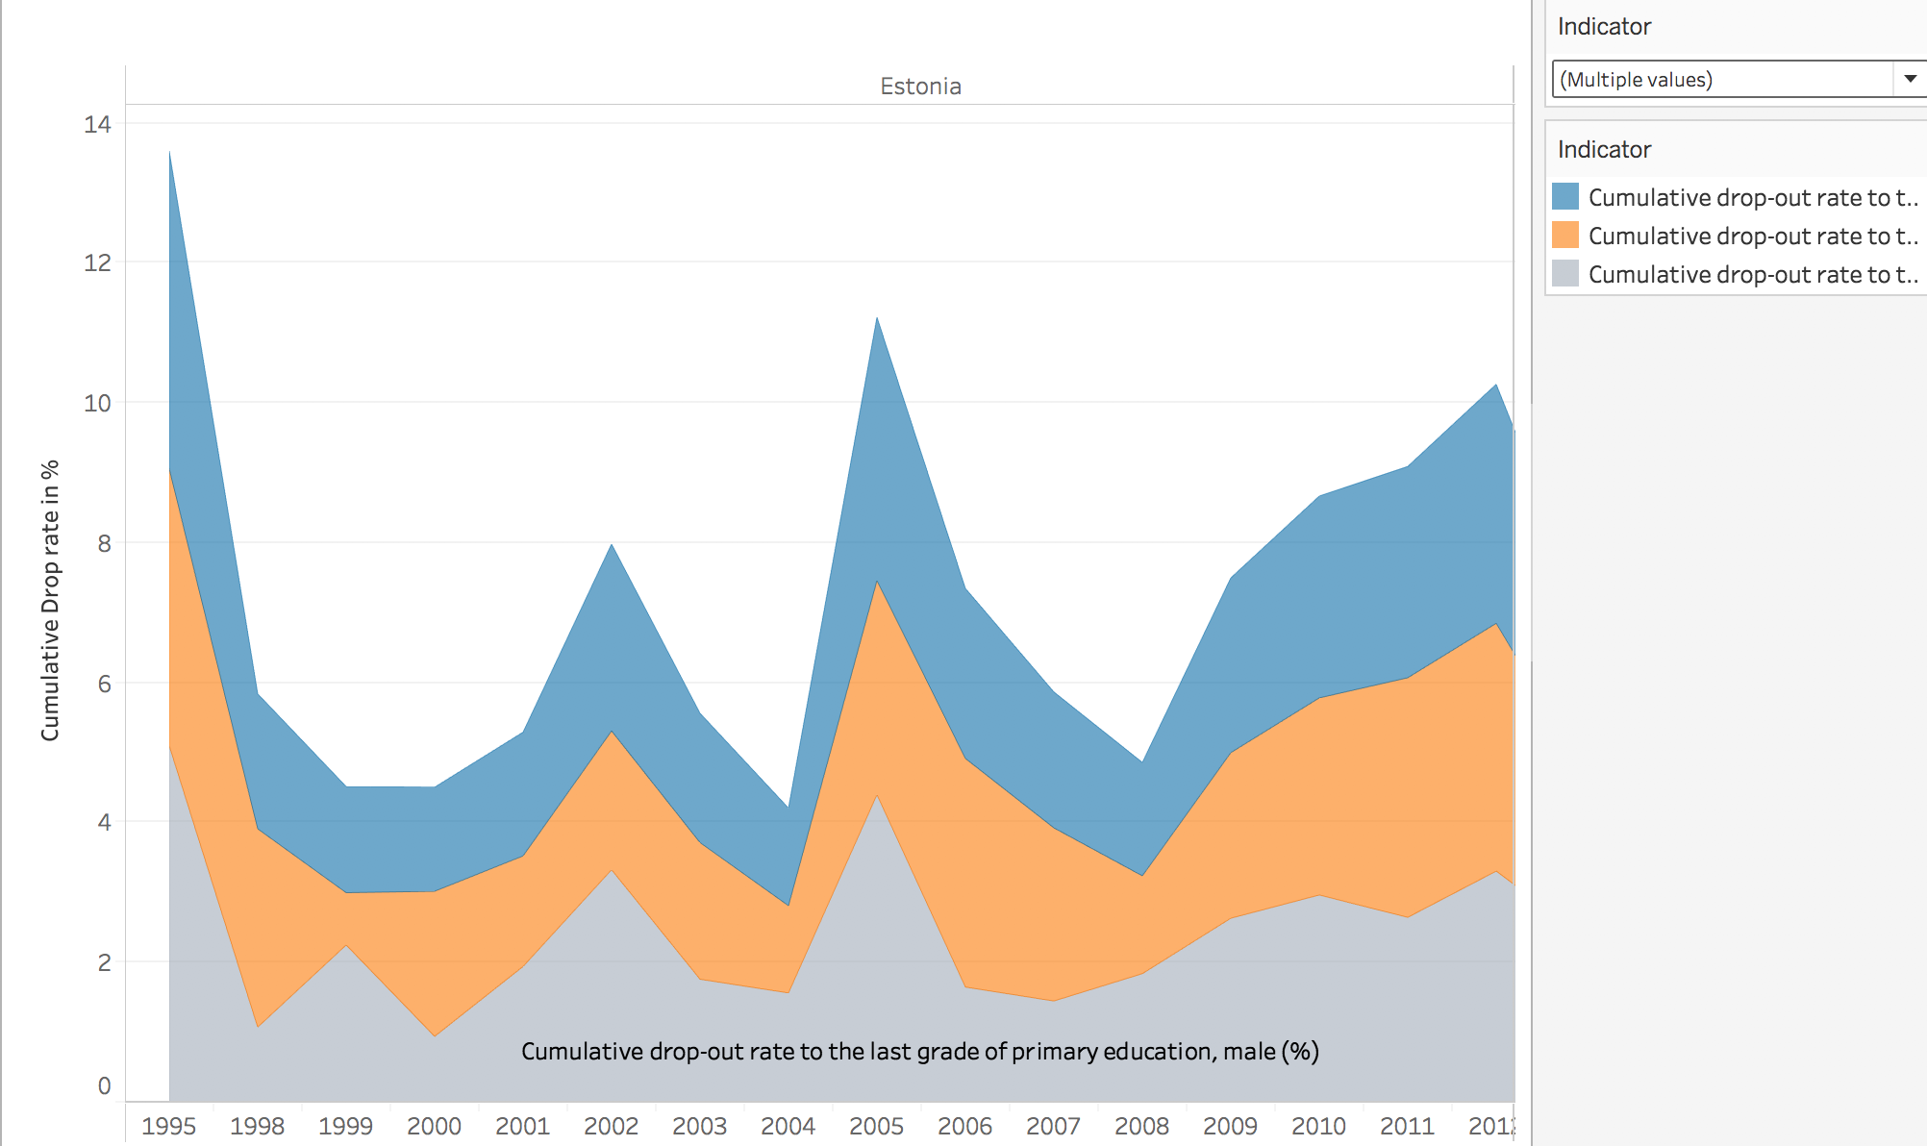
Task 4 - Dashboard Overview
Example Hypothesis: Cumulative drop out rate trend is influenced by female dropout rate
Unlinked Dynamic Visualisation
Filter enables user to select indicators
Current
Iteration
Line graphs could be explored
Show only education indicators which have cumulative, female and male rates in a specific view
Future
Iterations
Insight: Overall dropout rate is influenced more by female dropout rate, this helps policymakers to place more emphasis on female enrollment in addition to improve overall efforts to improve overall enrollment
Notes:
E.g. Hypothesis : Overall dropout rate is influenced more by female dropout rate,
this helps policy makers to place more emphasis female enrollment in addition to overall efforts to improve overall enrollment

